Slide 1
IBM University Engagement Project Submission
“Exploring the Power of Agentic AI with IBM Cloud and Watsonx AI”

Slide 2

Project Tile – Contract Review Agent
Domain of Project – Data Analytics
Project Live Url – https://contract-analysis-agent.vercel.app
GitHub Link – https://github.com/cs0787/contract-review-agent
Student Name | Recent Passport Photo | Email ID | Mobile number [WhatsApp]
Chetan Ashok Shakhapure |  | chetanshakhapure@gmail.com | 8080084253

Slide 3
Problem Statement -
Problem Statement – Developing an enterprise-grade AI solution for accurate contract risk analysis, compliance auditing, and policy redrafting using IBM watsonx.ai.
The Challenge
Organizations deal with thousands of legal documents every year, including Non-Disclosure Agreements (NDAs), employment contracts, vendor agreements, service contracts, purchase agreements, compliance policies, and internal company policies. Reviewing these documents manually is a time-consuming process that requires legal expertise and significant effort.
Many businesses, startups, HR teams, procurement departments, and legal professionals face challenges such as:
Missing mandatory legal clauses
Ambiguous or confusing language
Outdated regulatory references
Human review is often slow, expensive, and prone to oversight, especially when handling a large number of contracts.
The Objective
Build an AI-powered Contract Review Agent that automatically analyzes uploaded legal documents, identifies incorrect or risky clauses, checks compliance with company policies, and provides suggestions to improve clarity, accuracy, and legal quality

Slide 4
Proposed Solution -
The proposed solution is an intelligent AI-powered Contract Review Agent developed using IBM watsonx.ai Studio, IBM Granite Models, Retrieval-Augmented Generation (RAG), and enterprise knowledge bases.
Users upload legal documents such as NDAs, contracts, company policies, or agreements through a simple interface. The uploaded document is securely processed, analyzed, and compared against trusted legal guidelines, organizational standards, and predefined company policies.
The system first extracts document text and performs semantic analysis using IBM Granite language models. Through a Retrieval-Augmented Generation (RAG) architecture, the agent references company-approved legal documents and policy knowledge bases to ensure accurate, context-aware analysis.
The final review report includes:
Executive Summary
Compliance Status
Clause-by-Clause Analysis
Risk Level
Suggested Corrections
Missing Clauses
Overall Contract Score
IBM watsonx.ai.studio coordinates the workflow, while IBM Granite models provide advanced reasoning, summarization, legal analysis, and natural language generation.
The result is a scalable, enterprise-ready AI assistant capable of reducing contract review time from hours to minutes while improving consistency, accuracy, and compliance.

Slide 5
Technology Used
IBM Granite Model (Granite-3.0-8B-Instruct) – Performs contract understanding, legal
reasoning, clause analysis, summarization, and recommendation generation.
IBM watsonx.ai – Powers the foundation model used by the agent for intelligent contract review and natural language understanding.
RAG – Grounds the model in your uploaded document and live search results first, then generates contract reviews, eliminating AI hallucinations and making compliance audits verifiable.
IBM Cloud – Provides secure cloud infrastructure for hosting and running the agent.
Neon.tech Serverless PostgreSQL – Provides stateless session persistence, securing raw document texts, calculated vector weights, and conversation histories.
IBM BOB – For Assistance in Coding and building the frontend of the Agent.

Slide 6
CONTRX // AI Contract Review Agent Components
1) Input Interface (Chat & File Upload)
Modern, responsive interface where users can drag and drop draft corporate agreements (PDF, DOCX, TXT), paste clipboard text, or enter specific follow-up legal queries.
2) IBM watsonx AI Agent
Processes the local document context and user prompts using Granite models to generate professional legal risk assessments, policy gap analyses, and actionable redrafts.
3) IBM Granite Model - Granite-3.0-8B-Instruct
Fast, highly efficient, and instruction-tuned model selected for legal terminology reasoning, structuring compliance logic, and drafting clear contractual amendments.
5) Document Ingestion & Vector Index
Automatically parses uploaded documents on the fly using pypdf and python-docx, segmenting text into overlapping semantic chunks and caching them in-memory for local vector retrieval.
6) Live Web Search Integration (Tavily Search)
A background search component that crawls the web for live, real-world statutory updates, guidelines, and compliance standards, cross-referencing external facts to prevent model hallucinations.

Slide 7
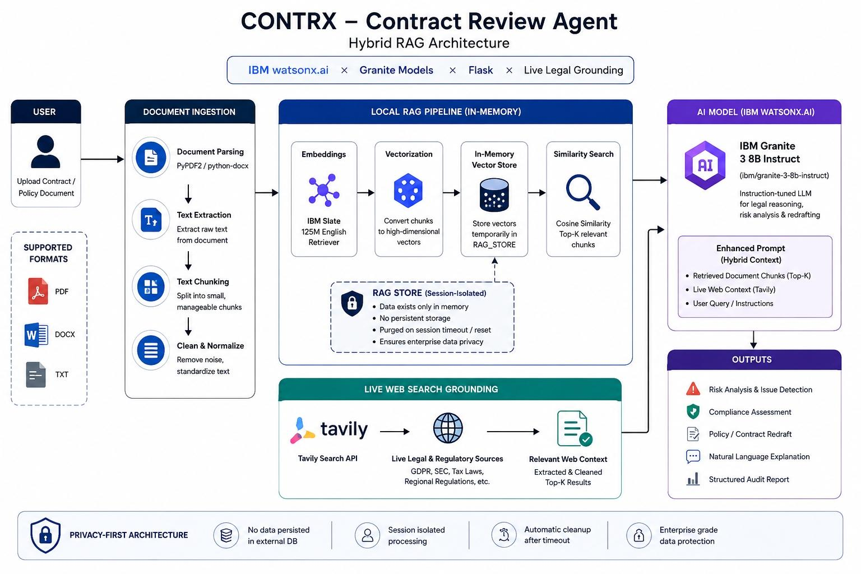
-

Slide 8
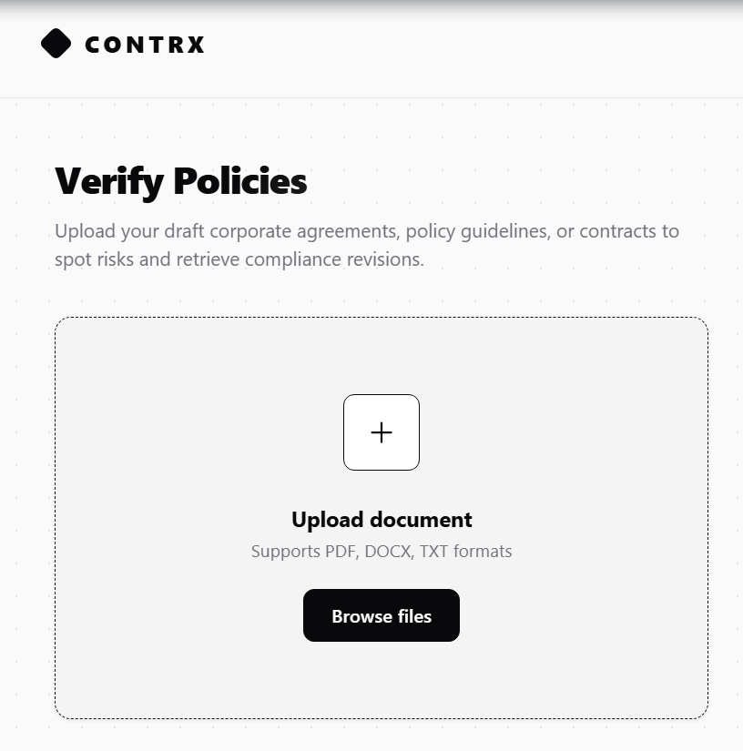
File upload section

Slide 9
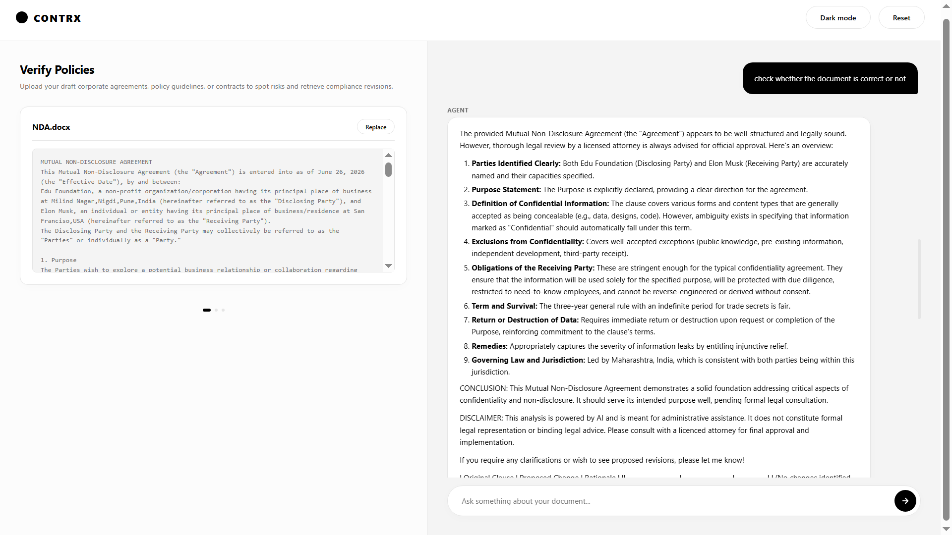
Prompt with output Screenshot:

Slide 10
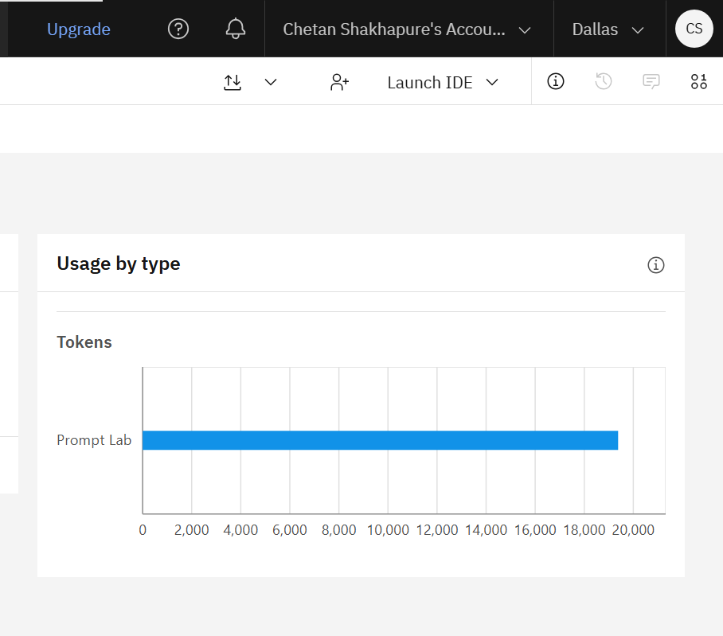
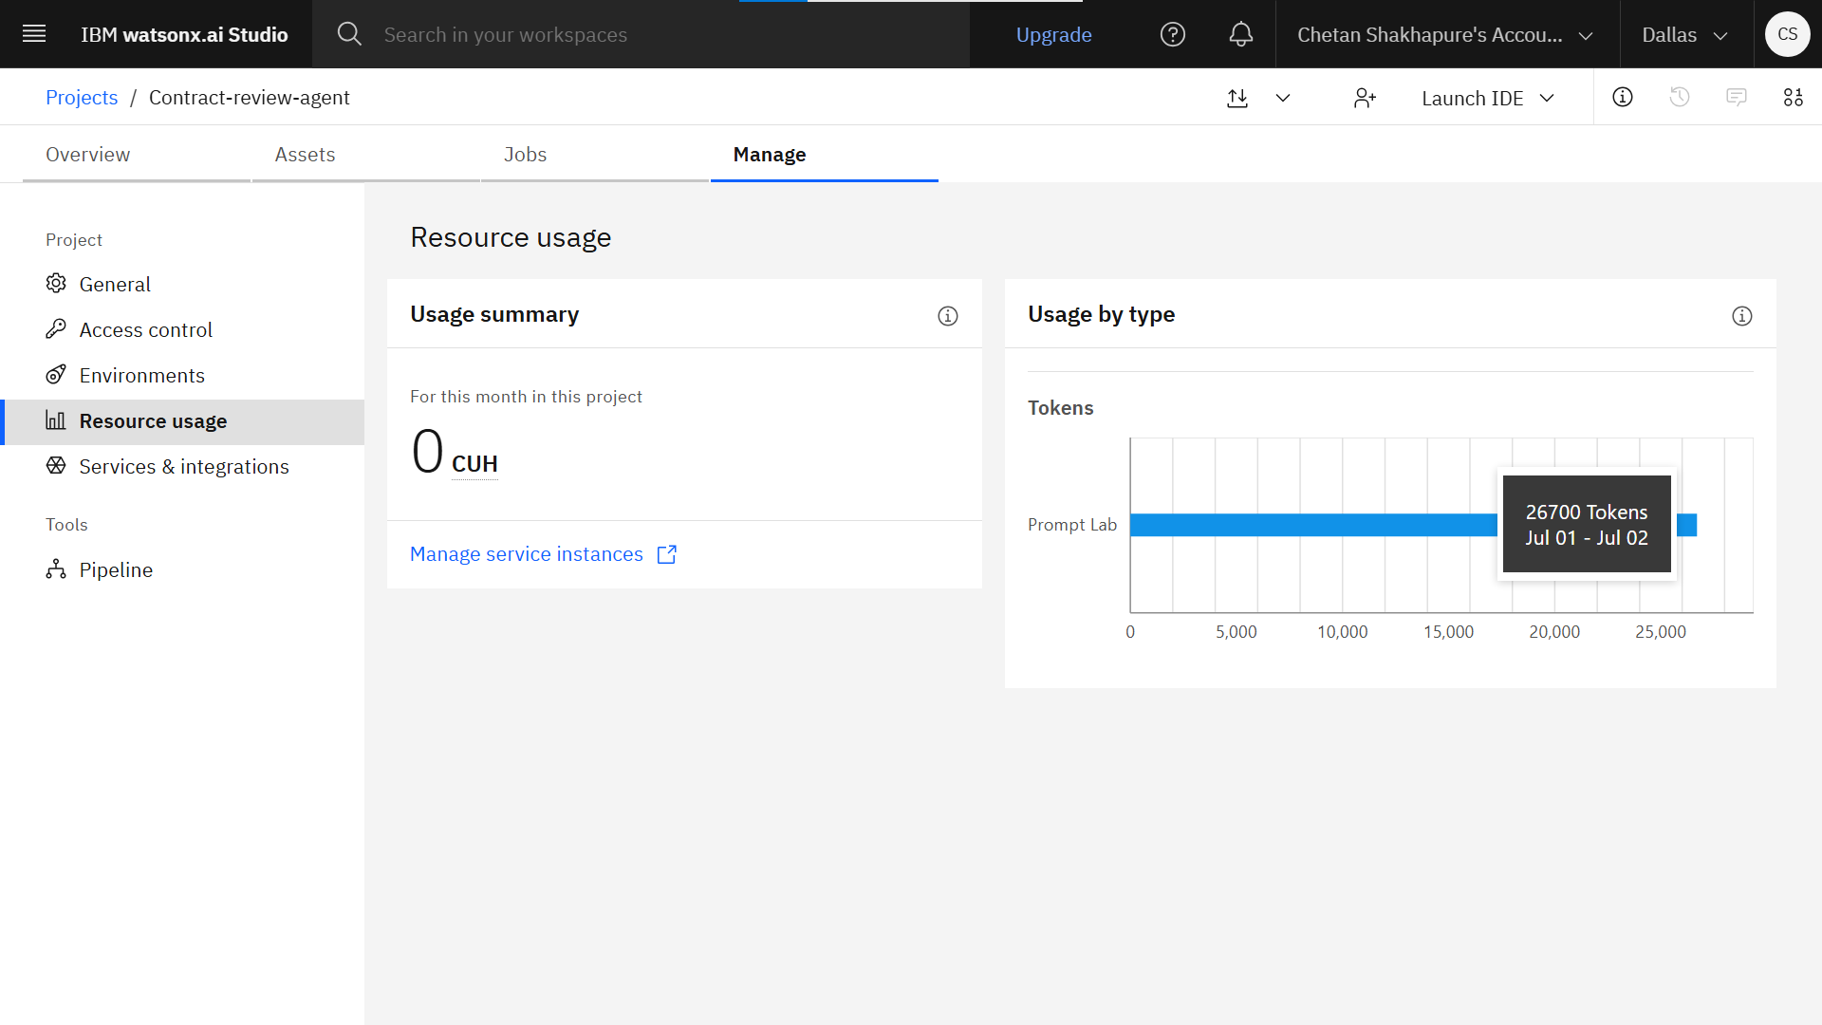
Token Usage
Before Prompt
After Prompt

Slide 11

Role of Agentic AI in the solution
Role of Agentic AI in Contract Review Agent →
Agentic AI enables the Contract Review Agent to perform intelligent and autonomous legal document analysis rather than simply responding to user prompts. When a user uploads a contract, the agent independently reads the document, understands its legal context, evaluates clauses, identifies potential risks, verifies compliance with organizational guidelines, and generates actionable recommendations.
The agent combines information from the uploaded document with the knowledge stored in the organizational knowledge base, allowing it to produce context-aware contract reviews. It explains identified issues in simple language, recommends stronger legal wording where necessary, and prepares a structured review report without requiring manual intervention.
By automating repetitive legal review tasks, Agentic AI helps organizations improve document quality, reduce review time, minimize legal risks, and maintain consistency across contracts.

Slide 12
Novelty and Uniqueness
Serverless Relational RAG Design: Rather than maintaining a heavy, expensive vector database, the application serializes vector embeddings as JSON and performs pure-Python similarity matching, maintaining low resource use
Stateless Resiliency: Engineered with an abstracted state layer using Neon Postgres, enabling Vercel to recycle containers freely without dropping active chat histories or text context.
Dual-Grounded Validation: Incorporates a custom-routed background crawler (Tavily Search API) to cross-reference static document clauses against up-to-date legal regulations, mitigating LLM hallucinations.
Instruction-Tuned Legal Persona: Programmed around IBM's Granite safety directives

Slide 13
Future Scope
Support multilingual legal document analysis.
Compare different versions of contracts to identify changes.
Generate AI-based legal risk scores for uploaded agreements.
Integrate with digital signature platforms for end-to-end contract management.
Expand compliance verification for standards such as GDPR, ISO, HIPAA, and other regulatory frameworks.
·
·

Slide 14
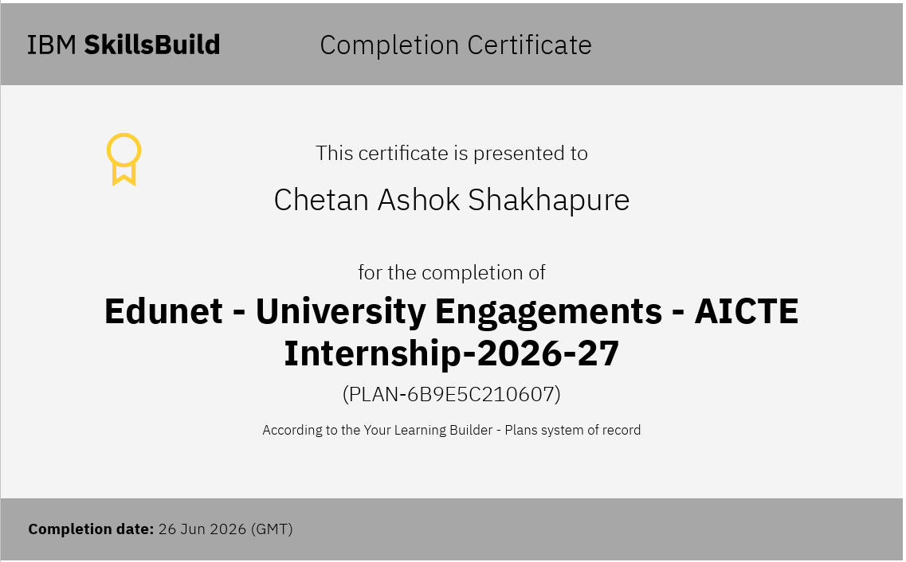
Completion Certificate

Slide 15
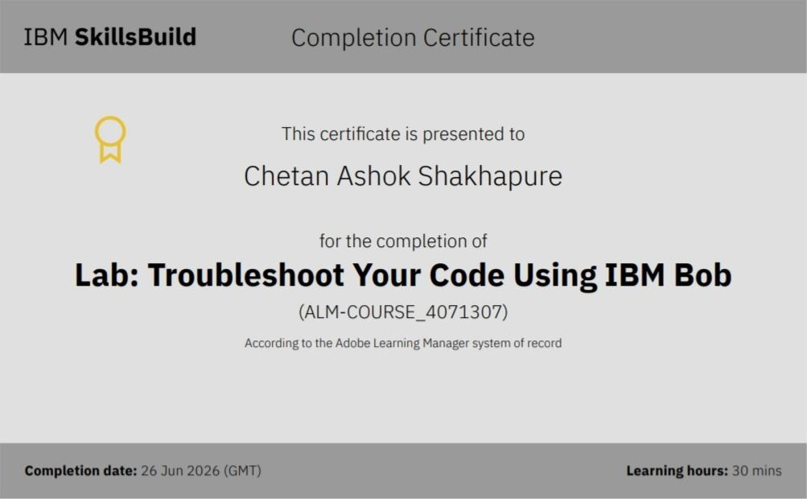
IBM BOB

Slide 16
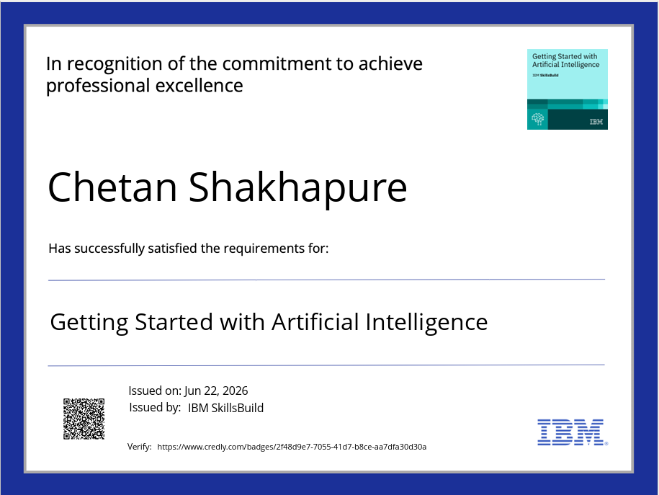
Certificates Earned:

Slide 17
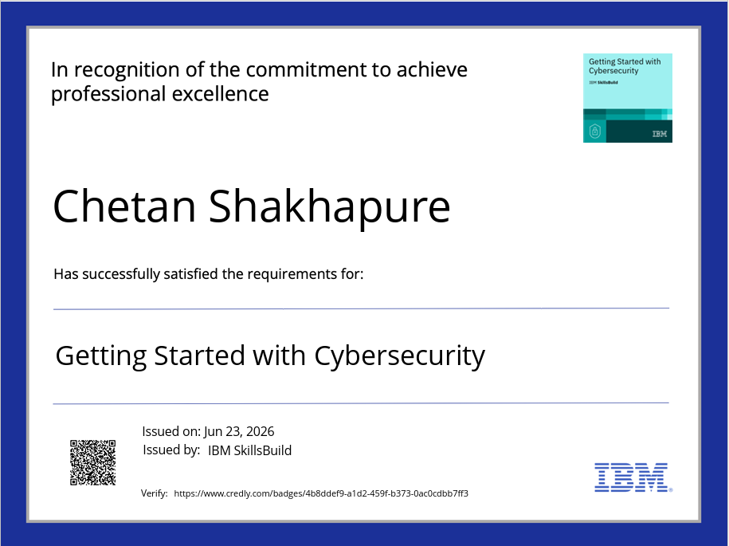
Certificates Earned:​

Slide 18


